Slide 1
PTSD
What's the difference between trauma and PTSD?
Symptoms
Cognition/Mood
Longevity
PTSD
Re-experiencing
Avoidance
Arousal/Reactivity
Notes:
PTSD: Definition
Level: Beginning/Intermediate/Clinical
Discussion
PTSD is the acronym for Post Traumatic Stress Disorder
PTSD requires specific symptoms after trauma including prolonged re-experiencing of the event, avoidance from people, places, feelings, or things related to the trauma, increased arousal, and changes in cognition and mood for at least 1 month (NIH, 2019).
Like discussed with Resilience and Post Traumatic Growth, when one’s symptoms of trauma do NOT resolve, PTSD can emerge (among other mental health diagnoses).
Examples:
Re-experiencing examples: flashbacks, nightmares, intruding thoughts
Avoidance examples: Staying away from places, events, or objects that are reminders of the traumatic experience, or avoiding thoughts and feelings about the traumatic event.
Arousal examples: Being easily startled, feeling tense and on edge, having difficulty sleeping, angry outbursts
Cognition/Mood examples: Trouble remembering key features of the traumatic event, Negative thoughts about oneself or the world, Distorted feelings like guilt or blame, Loss of interest in enjoyable activities
All people with PTSD have trauma... not all people with trauma have PTSD
Further Learning on PTSD:
U.S. Department of Veteran Affairs' National Center for PTSD website has a plethora of resources, information, mobile apps, and more on PTSD. https://www.ptsd.va.gov/index.asp
Sources:
National Institute of Mental Health [NIH]. (2019, May). Post-Traumatic Stress Disorder. https://www.nimh.nih.gov/health/topics/post-traumatic-stress-disorder-ptsd

Slide 2
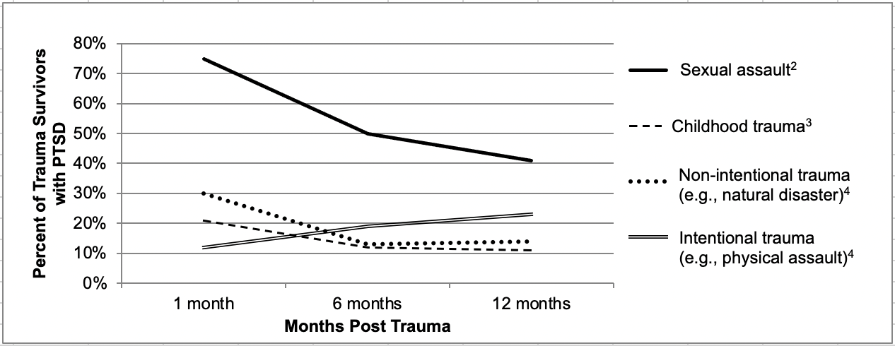
PTSD
Prevalence
(ISTSS, 2020)
Notes:
PTSD: Prevalence
Level: Beginning/intermediate/Clinical
Discussion
It is estimated that 3.6% of US adults had PTSD in the past year and 6.8% of US adults would have PTSD some point in their lifetime (NCS, 2017; NIH, n.d.)
Like discussed with Resilience and Post Traumatic Growth, when one’s symptoms of trauma do NOT resolve, PTSD can emerge (among other mental health diagnoses).
Most people do NOT have PTSD 1 year after trauma, regardless of type. (ISTSS, 2020).
Sources
Harvard Medical School, 2007. National Comorbidity Survey (NCS). (2017, August 21). Retrieved from https://www.hcp.med.harvard.edu/ncs/index.php. Data Table 2: 12-month prevalence DSM-IV/WMH-CIDI disorders by sex and cohort.
Harvard Medical School, 2007. National Comorbidity Survey (NCS). (2017, August 21). Retrieved from https://www.hcp.med.harvard.edu/ncs/index.php. Data Table 1: Lifetime prevalence DSM-IV/WMH-CIDI disorders by sex and cohort.
International Society for Traumatic Stress Studies. (2020). What Happens After Trauma?: Understanding Natural Recovery vs. PTSD [Fact Sheet]. https://istss.org/ISTSS_Main/media/Documents/Natural-Recovery-FINAL-with-QR-Code.pdf
National Institute of Mental Health [NIH]. (n.d.). Post-Traumatic Stress Disorder (PTSD). https://www.nimh.nih.gov/health/statistics/post-traumatic-stress-disorder-ptsd

Slide 3
Complex PTSD
What’s the difference between pstd and c-ptsd?
PTSD Symptoms and longevity
Problems in:
Complex PTSD
Re-experiencing
Avoidance
Arousal/Reactivity
Cognition/Mood
Emotional regulation
Self image
Interpersonal relationships
Notes:
Complex PTSD
Level: Intermediate/Clinical
Discussion
Definition: C-PTSD is a mental health condition that also may be diagnosed by a professional when someone has experienced a traumatic event. C-PTSD shares many symptoms in common with PTSD, including re-experiencing, avoidance, and hyperarousal, as described above. However, C-PTSD also includes:
Problems in emotion regulation, like having difficulty managing one's feelings
Problems in self-image, like feeling completely different from other people and/or having a negative self-view
Interpersonal problems, including having trouble trusting others
(ISTSS, 2020)
Sources
International Society for Traumatic Stress Studies [ISTSS]. (2020). Trauma During Adulthood. https://istss.org/public-resources/trauma-basics/trauma-during-adulthood

